Slide 1
Facial emotion detection using ML
BE . Computer Science & Engineering
Satyam College of Engineering & Technology

Slide 2
Facial emotion detection using ML
Guided By
Mrs. D.SHEEBA M.E,
SUPERVISOR,
ASSOCIATE PROFESSOR
Submitted By
Panchuarun M 962020104012

Slide 3
Abstract
Facial Expression conveys non-verbal cues, which plays an important roles in interpersonal relations.
The Facial Expression Recognition system is the process of identifying the emotional state of a person.
In this system captured image is compared with the trained dataset available in database and then emotional state of the image will be displayed.
This system is based on image processing and machine learning.
The recognition performance of the proposed method will be evaluated by using the trained database with the help of Support Vector Machine.

Slide 4
Introduction
A Facial expression is the visible manifestation of the affective state, cognitive activity, intention, personality and psychopathology of a person and plays a communicative role in interpersonal relations. State the desired objective.
Generally human beings can convey intentions and emotions through nonverbal ways such as gestures, facial expressions and involuntary languages. This system can be significantly useful, nonverbal way for people to communicate with each other.
The important thing is how fluently the system detects or extracts the facial expression from image. The system is growing attention because this could be widely used in many fields like lie detection, medical assessment and human computer interface.

Slide 5

Why Emotion Detection?
The motivation behind choosing this topic specifically lies in the huge investments large corporations do in feedbacks and surveys but fail to get equitable response on their investments.
Emotion Detection through facial gestures is a technology that aims to improve product and services performance by monitoring customer behavior to certain products or service staff by their evaluation

Slide 6



Some Companies that make us of emotion detection...
While Disney uses emotion-detection tech to find out opinion on a completed project, other brands have used it to directly inform advertising and digital marketing.
Kellogg's is just one high-profile example, having used Affectiva's software to test audience reaction to ads for its cereal.
Unilever does this, using HireVue's Al-powered technology to screen prospective candidates based on factors like body language and mood. In doing so, the company is able to find the person whose personality and characteristics are best suited to the job.

Slide 7
Existing system
Research in the fields of face detection and tracking has been very active and there is exhaustive literature available on the same.
The major challenge that the researchers face is the non-availability of spontaneous expression data .
Capturing spontaneous expressions on images and video is one of the biggest challenges ahead .

Slide 8
Proposed system
In proposed system study of reliable and effective algorithms is done.
On the other hand data were collected and were preprocessed for more fine and accurate results.
Since huge amount of data were needed for better accuracy we have collected the data surfing the internet.
Since, we are new to this project we have decided to use local binary pattern algorithm for feature extraction and support vector machine for training the dataset.
We have decided to implement these algorithms by using OpenCv framework.

Slide 9
Requirements
Hardware Requirements
Fluently working Laptops
RAM minimum 4Gb
Web Camera / Laptop Camera
Software Requirements
Python Software
VSCode
OpenCV framework
Windows / Linux

Slide 10
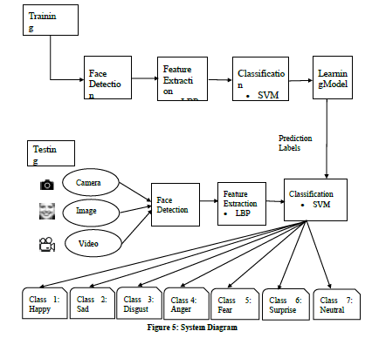
Architectural diagram

Slide 11
Data collection
Cohn-Kanade (CK+) Facial Expression Database
Face expression recognition (FER) Database

Slide 12
CK+ Facial expression database
Subjects in the released portion of the CK+ Facial Expression Database are 100 university students.
They ranged in age from 18 to 30 years.
Sixty-five percent were female, 15 percent were African-American, and three percent were Asian or Latino.
Subjects were instructed by an experimenter to perform a series of 23 facial displays that included single action units and combinations of action units.

Slide 13
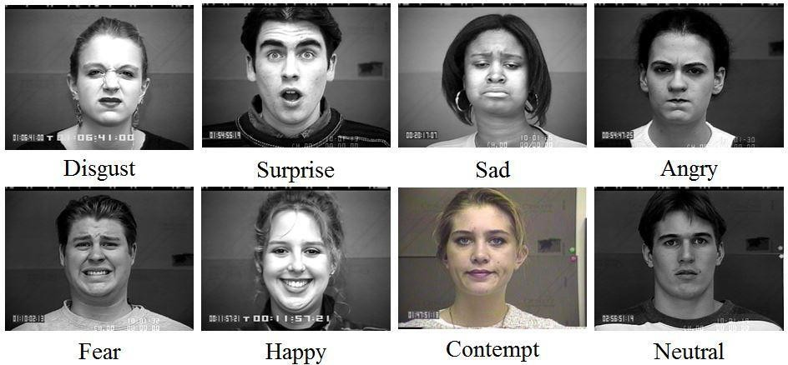
Sample images of dataset

Slide 14
Face expression recognition database
This database contains 213 images in total. There are 10 subjects and 7 facial expressions for each subject.
Each subject has about twenty images and each expression includes two to three images.
The seven expressions are angry, happy, disgust, sadness, surprise, fear and neutral respectively

Slide 15
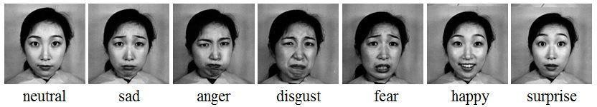
Sample images of dataset

Slide 16
Modules
Image Acquisition
Face detection
Image Pre-processing
Feature Extraction
Classification

Slide 17
Image Acquisition
Images used for facial expression recognition are static images or image sequences. Images of face can be captured using camera.
Face detection
Face Detection is useful in detection of facial image.
Face Detection is carried out in training dataset using Haar classifier called Voila-Jones face detector and implemented through Opencv.
Haar like features encodes the difference in average intensity in different parts of the image and consists of black and white connected rectangles in which the value of the feature is the difference of sum of pixel values in black and white regions

Slide 18
Image pre-processing
Image pre-processing includes the removal of noise and normalization against the variation of pixel position or brightness.
Color Normalization
Histogram Normalization
Feature extraction
Selection of the feature vector is the most important part in a pattern classification problem.
The image of face after pre-processing is then used for extracting the important features.

Slide 19
Classification
The dimensionality of data obtained from the feature extraction method is very high so it is reduced using classification.
Features should take different values for object belonging to different class so classification will be done using Support Vector Machine algorithm.

Slide 20
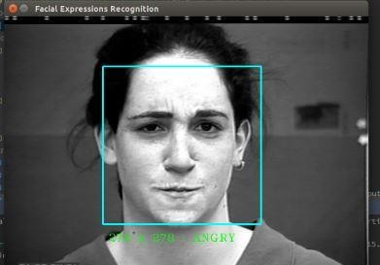
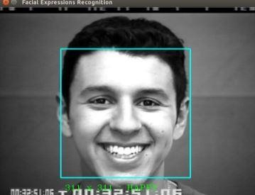
Experimental Demonstration

Slide 21
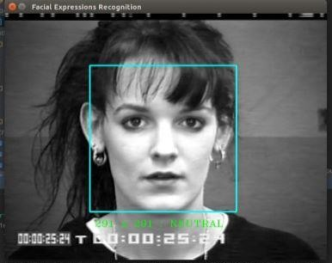
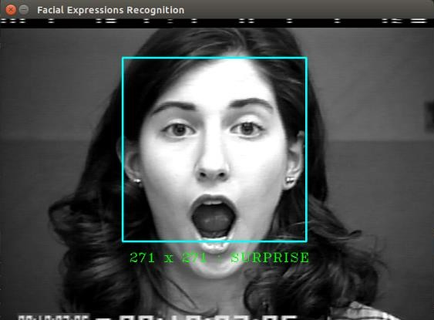

Slide 22
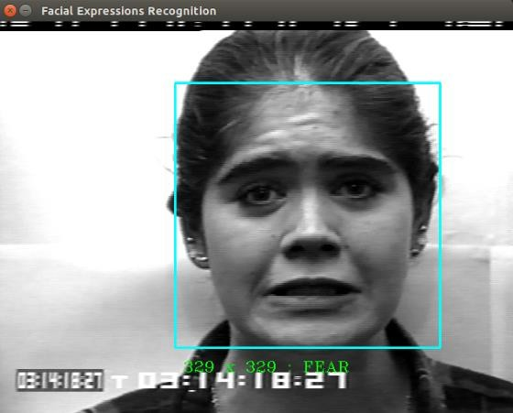
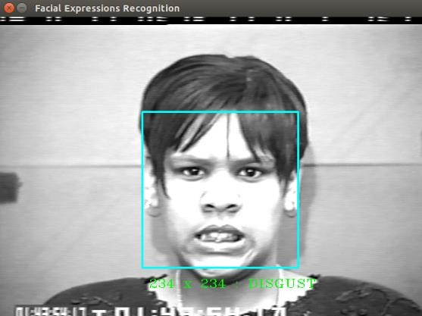

Slide 23
Conclusion
This project proposes an approach for recognizing the category of facial expressions.
Face Detection and Extraction of expressions from facial images is useful in many applications, such as robotics vision, video surveillance, digital cameras, security and human-computer interaction.
This project’s objective was to develop a facial expression recognition system implementing the computer visions and enhancing the advanced feature extraction and classification in face expression recognition.
In this project, seven different facial expressions of different persons’ images from different datasets have been analyzed.

Slide 24
References
Bettadapura, V. (2012). Face expression recognition and analysis: the state of the art. arXiv preprint arXiv:1203.6722.
Shan, C., Gong, S., & McOwan, P. W. (2005, September). Robust facial expression recognition using local binary patterns. In Image Processing, 2005. ICIP 2005. IEEE International Conference on (Vol. 2, pp. II-370). IEEE.
Bhatt, M., Drashti, H., Rathod, M., Kirit, R., Agravat, M., & Shardul, J. (2014). A Study of Local Binary Pattern Method for Facial Expression Detection. arXiv preprint arXiv:1405.6130.
Chen, J., Chen, Z., Chi, Z., & Fu, H. (2014, August). Facial expression recognition based on facial components detection and hog features. In International Workshops on Electrical and Computer Engineering Subfields (pp. 884-888).
Ahmed, F., Bari, H., & Hossain, E. (2014). Person-independent facial expression recognition based on compound local binary pattern (CLBP). Int. Arab J. Inf. Technol., 11(2), 195-203.

